Slide 1

Université de Mostaganem — Dr. Madani BELACEL
TD TIC 09 Reseaux Informatiques EN
Module TIC — Dr. BELACEL Madani
Université de Mostaganem — MCB

Slide 2
Université de Mostaganem — Dr. Madani BELACEL
🎯 Objectifs pédagogiques
• Comprendre les concepts clés
• Appliquer les compétences
• Évaluer les technologies

Slide 3
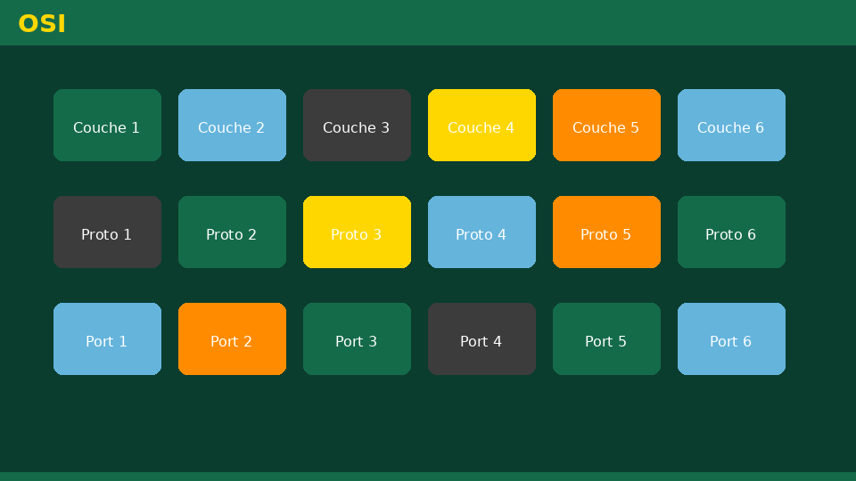
Université de Mostaganem — Dr. Madani BELACEL
📋 Plan du cours
• Exercise 1 — Types of networks
• Exercise 2 — Topologies
• Exercise 3 — Network components
• Exercise 4 — Addressing and DHCP
• Exercise 5 — Campus case

Slide 4
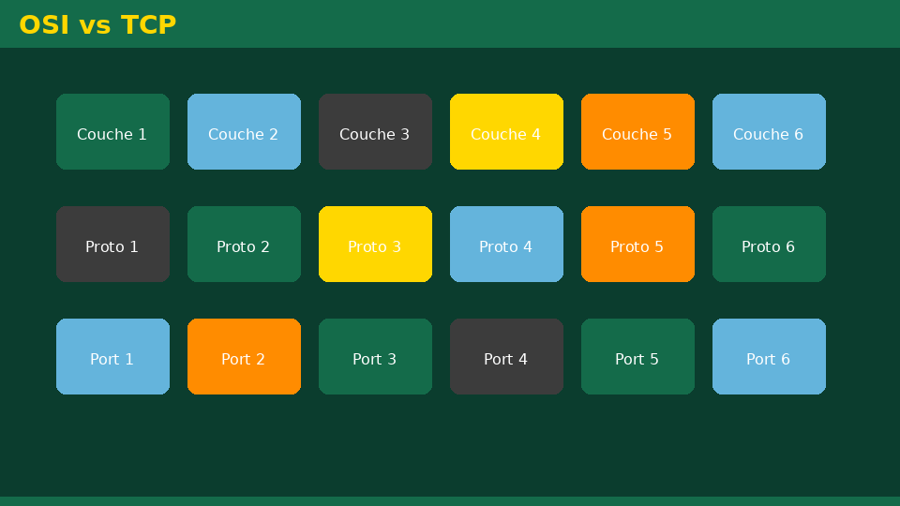
Exercise 1 — Types of networks
• Statement:Associate LAN, MAN, WAN with: computer room, city network, global Internet.
• Detailed correction:- Computer room → LAN (Local Area Network). - City network → MAN (Metropolitan Area Network). - Worldwide Internet → WAN (Wide Area Network).
Université de Mostaganem — Dr. Madani BELACEL

Slide 5

Exercise 2 — Topologies
• Statement:Draw a star topology with 4 stations and a central switch. Name a benefit.
• Detailed correction:- 4 PCs individually connected to the switch (central hub). - Advantage: failure of a cable only affects one station; easy troubleshooting. - Very common in Wi-Fi (access point = center).
Université de Mostaganem — Dr. Madani BELACEL

Slide 6

Exercise 3 — Network components
• Statement:Connect component and role: switch, router, network card, Ethernet cable.
• Detailed correction:- Switch: interconnects machines via LAN. - Router: connects LAN to the Internet (IP routing). - Network card (NIC): machine/network interface. - Ethernet cable: wired transmission medium.
Université de Mostaganem — Dr. Madani BELACEL

Slide 7

Exercise 4 — Addressing and DHCP
• Statement:A station displays169.254.x.x. What likely problem? Which protocol resolves IP assignment?
• Detailed correction:- APIPA address: no DHCP server reachable (Wi-Fi not connected or box turned off). - DHCP must assign IP, mask, gateway, DNS. - Solution: check Wi-Fi/Ethernet connection, restart box, contact IT support.
Université de Mostaganem — Dr. Madani BELACEL

Slide 8

Exercise 5 — Campus case
• Statement:Propose 3 rules for good use of the university network.
• Detailed correction:1. Educational and research use (no illegal downloads). 2. Do not share institutional Wi-Fi credentials. 3. Respect the IT charter (security, bandwidth, shared printers).
Université de Mostaganem — Dr. Madani BELACEL

Slide 9
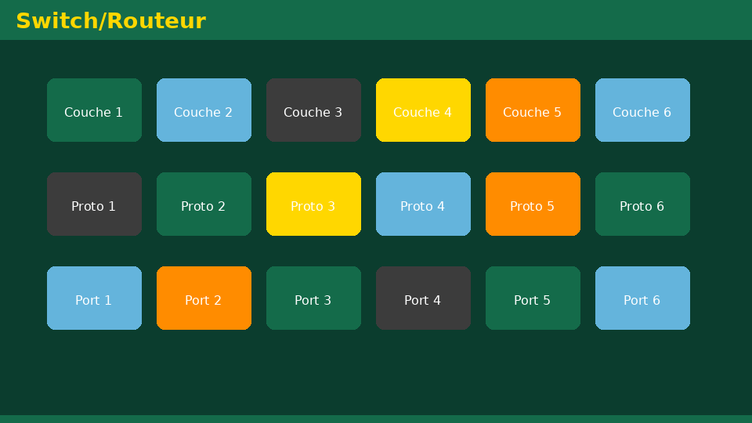
• Statement:Associate LAN, MAN, WAN with: computer room, city network, global Internet.
• Statement:Draw a star topology with 4 stations and a central switch. Name a benefit.
• Statement:Connect component and role: switch, router, network card, Ethernet cable.
📝 Points clés à retenir
Université de Mostaganem — Dr. Madani BELACEL

Slide 10

• Statement:Associate LAN, MAN, WAN with: computer room, city network, global Internet.
• Statement:Draw a star topology with 4 stations and a central switch. Name a benefit.
• Statement:Connect component and role: switch, router, network card, Ethernet cable.
📝 Points clés à retenir
Université de Mostaganem — Dr. Madani BELACEL

Slide 11

• Statement:Associate LAN, MAN, WAN with: computer room, city network, global Internet.
• Statement:Draw a star topology with 4 stations and a central switch. Name a benefit.
• Statement:Connect component and role: switch, router, network card, Ethernet cable.
📝 Points clés à retenir
Université de Mostaganem — Dr. Madani BELACEL

Slide 12

• Statement:Associate LAN, MAN, WAN with: computer room, city network, global Internet.
• Statement:Draw a star topology with 4 stations and a central switch. Name a benefit.
• Statement:Connect component and role: switch, router, network card, Ethernet cable.
📝 Points clés à retenir
Université de Mostaganem — Dr. Madani BELACEL

Slide 13

Université de Mostaganem — Dr. Madani BELACEL
📝 Points clés à retenir
• Statement:Associate LAN, MAN, WAN with: computer room, city network, global Internet.
• Statement:Draw a star topology with 4 stations and a central switch. Name a benefit.
• Statement:Connect component and role: switch, router, network card, Ethernet cable.
• Statement:A station displays169.254.x.x. What likely problem? Which protocol resolves IP assignment?
• Statement:Propose 3 rules for good use of the university network.

Slide 14

Université de Mostaganem — Dr. Madani BELACEL
✏️ Exercices d'application
• Définir les concepts principaux du cours
• Identifier les applications pratiques
• Résoudre les exercices du TD
• Synthétiser les points clés en un paragraphe
• Préparer une courte présentation orale

Slide 15
Université de Mostaganem — Dr. Madani BELACEL
🎓 Conclusion
Dr. BELACEL Madani Maître de Conférences B Université de Mostaganem madani.belacel@univ-mosta.dz

